Slide 1
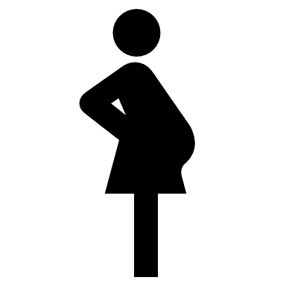
Covid 19 Risk reduction framework
Council logo
Workplace
Assessment
Workforce Assessment
1
2
3
Individual assessment
Sex / Age / Ethnicity
Males over 40 at higher risk serious Covid 19 conditions
BAME ethnicity, particularly in those with co-morbidities
White European aged over 60
Pregnancy
All pregnant women should have a risk assessment
Women >28 weeks pregnant should only work where risk assessment supports this.
Underlying health conditions and Disabilities inc:
Hypertension
Cardiovascular Disease (CVD)
Diabetes Mellitus (DM)
Chronic Kidney Disease (CKD)
Chronic Obstructive Pulmonary Disease (COPD)
Obesity
Personal Situational factors
mental wellbeing
household arrangements
household shielding/ vulnerable protection arrangements
Managers to discuss implications and to take appropriate measures to mitigate risk of Covid-19 to H&F staff

Slide 2
Covid 19 Risk reduction - key consideration elements
Council logo
Workplace Assessment
Take into consideration workplace setting
Potential exposure to Covid in the workplace
Application of an appropriate hierarchy of control measures including:
Elimination if possible
Reduction by hygiene measures
Safe systems of work
Correct use of PPE including training
Workforce Assessment
Identify those individuals with increased vulnerability to infection or poorer outcomes from Covid-19 e.g. because of nature of the work and likelihood of contact/ exposure to members of the public
Guidance has identified three categories of vulnerability:
Specific long term health conditions
Older age
Pregnancy
Evidence suggests that ethnicity of a BAME background may also be associated with increased vulnerability
Evidence of males being at higher risk with UK data showing approximately 60% of people being admitted to hospital being male
Availability of appropriate redeployment options
1
2
3
Individual Assessment
Six factors need to be considered:
Sex (gender) – working males over 40 years twice as likely to die
Age: Those aged over 70 have already been identified as clinically vulnerable
Ethnicity: Bangladeshi had twice death rate of white ethnicity, and other BAME (black, Asian, minority ethnic) groups appear to be at increased risk of 10 – 50% higher death rate than white British.
Health & Disability - Clinically vulnerable people: Those with underlying health conditions or co-morbidities and those with Disabilities which may be the subject of reasonable adjustments
Pregnancy: In particular those who are over 28 weeks or have underlying health conditions
Personal situational factors – such as mental wellbeing, household arrangements, household shielding/ vulnerable protection

Slide 3
Covid-19 Secure workplaces Model Risk Assessment Process
1 - Operational Manager completes risk assessment for their service using corporate template
2 - Manager discusses risk assessment with Health and Safety team
3 - Health and Safety team reviews and provides feedback as necessary
4 - Manager shares results of the risk assessment with team
5 - Manager shares draft risk assessment with TUs
10 – Log of risk assessments completed.
11- Manager keeps risk assessment under monthly review as a live document.
9 - Manager posts in appropriate area in workplace and on intranet
6 – Risk assessment finalised
7 - Manager presents risk assessment to senior management as appropriate
8 - Manager circulates agreed risk assessment to team and TUs

