Slide 1

A secure intelligent data repository powering the HR Metrics Benchmarking Club for councils in England
Share and compare workforce metrics from Pay, Recruitment & Retention, Agency-use, Terms and Conditions to Diversity, Absence, Leavers/Turnover and more.
Benchmark HR Metrics data plus the work HR Teams do, outsource and share; the apps and systems they use. Work together to innovate and inform decisions. For more information go to:
www.infinistats.com/club

Slide 2









Over 140 HR Benchmarking Club Councils in:

Slide 3
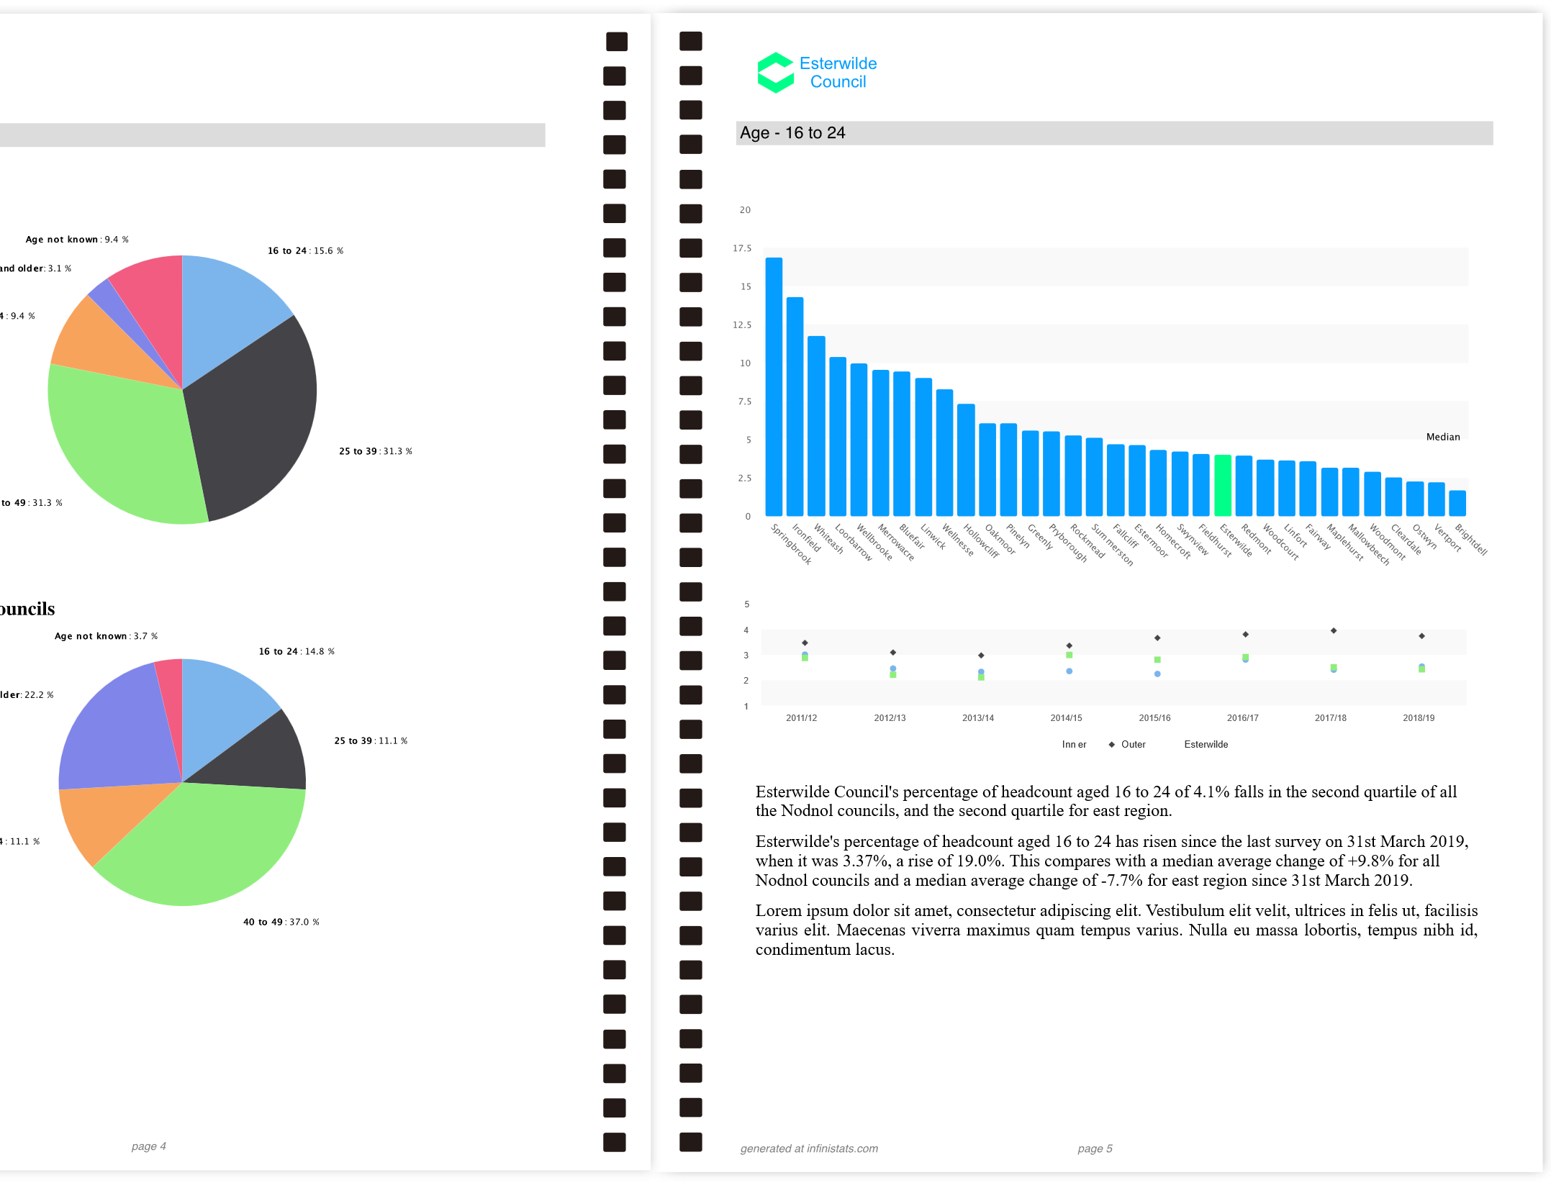
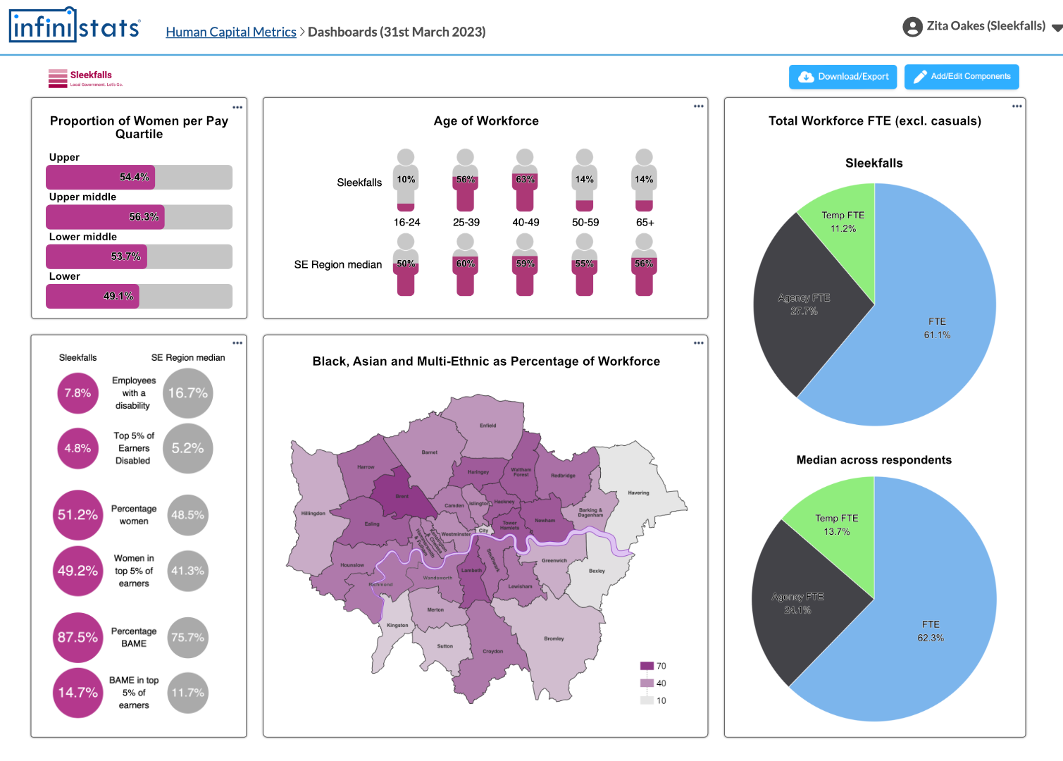
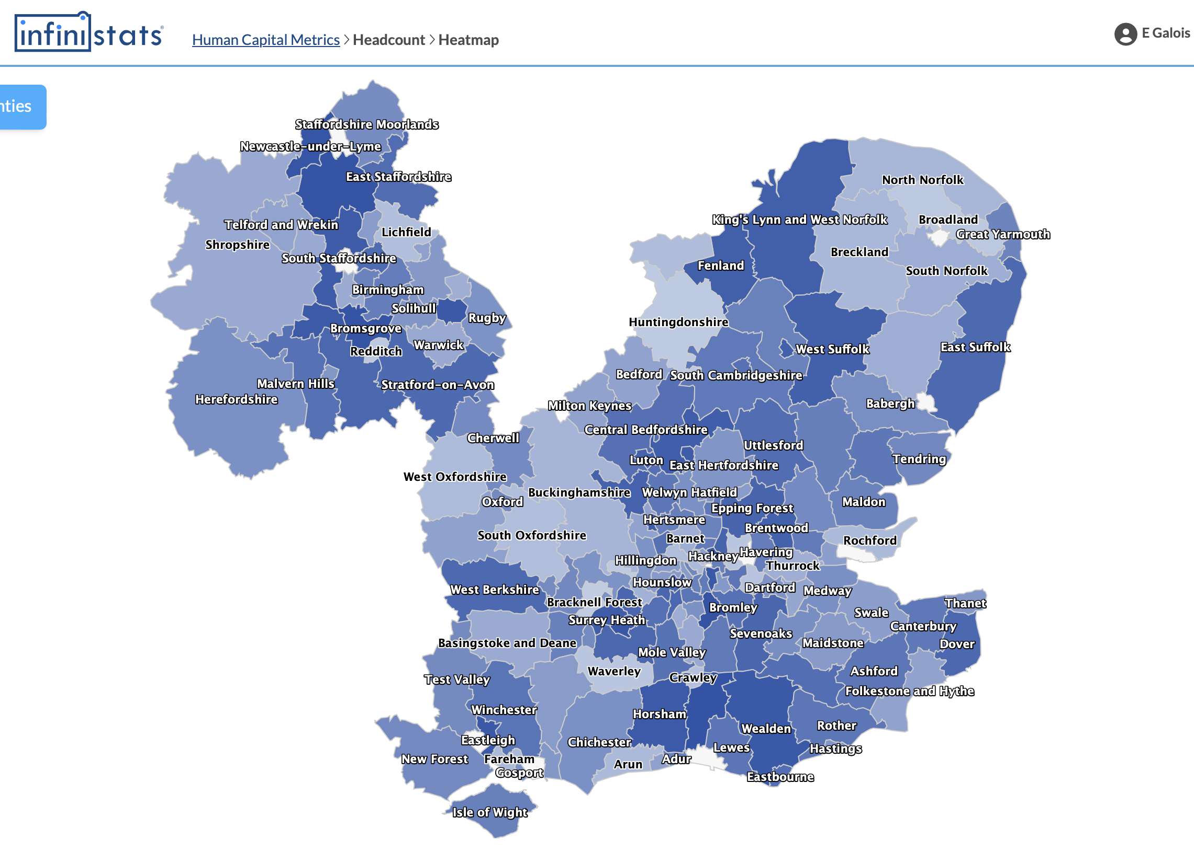

HR Metrics Benchmarking Club with
The HR metrics benchmarking club provides a wide range of HR metrics surveys, including pay benchmarking, and access to the full InfiniStats » data entry and reporting functionality.
One-click reporting & scorecards that use your council’s branding
Create and share dashboards with a range of presets
Rich data visualisations including heatmaps
I’ve been a London Council member of InfiniStats for 15 years. [...] The system is so easy to use, more importantly, the reporting is brilliant."
I have used InfiniStats for a number of years. For inputting data, it couldn’t be simpler. Extracting data and reports is also quick and easy. [...] It’s very user friendly."
As a long-term user, I have found InfiniStats to be a valuable tool for workforce benchmarking. It is robust with a quick and intuitive interface."
Contact your regional employer to sign up or for more information

Slide 4







HR Metrics Benchmarking Club with
The Surveys
Best-Practice HR KPIs
  Human Capital Metrics – workforce size/diversity, sickness by reason, leavers
  Gender Pay Gap
  HR Outputs – HR Casework training days/cost, recruitment time, appraisals
Pay Data
  Chief Officer pay & benefits
  Pay & benefits - other roles
  Min/Max packages/other payments.
  R&R difficulty
  Agency CSW pay-rates
HR Policy
  Terms & conditions
  Systems/apps
  HR delivery partners
  Shared HR services
  Size of HR Teams
InfiniStats
  Create your own surveys to collect data from councils in your region
  Email notifications to all users when new surveys are created
All surveys are voluntary, complete what you can to take part.

Slide 5


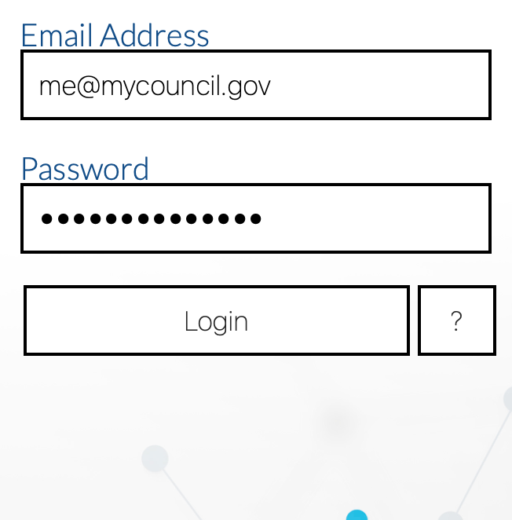
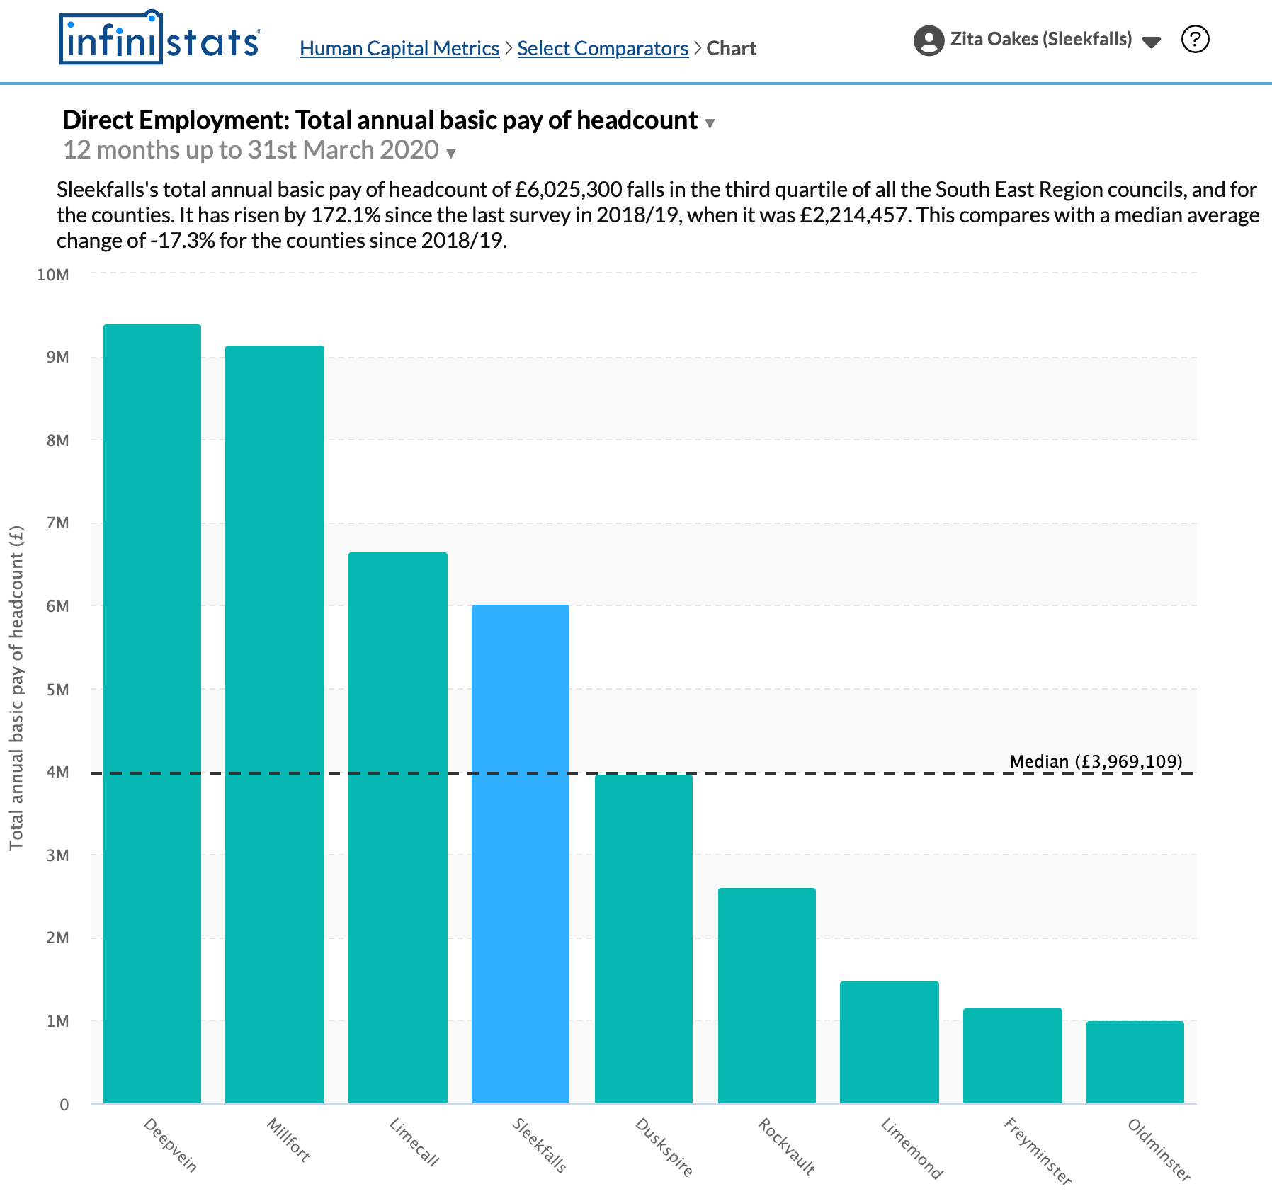

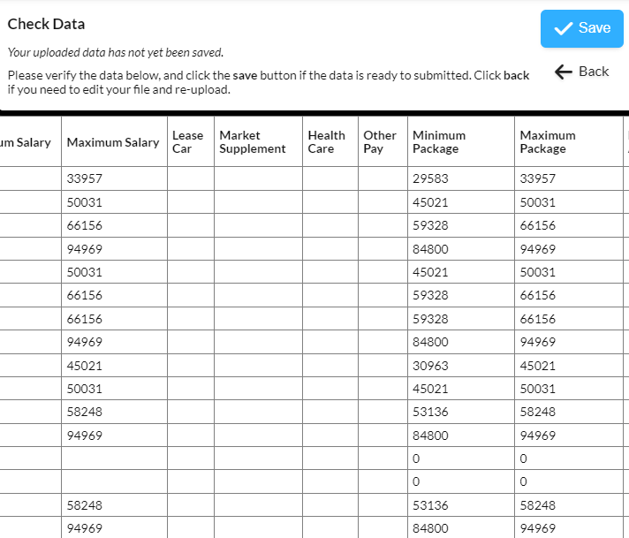

Joining the Club and Using InfiniStats
Setup
(first time only)
Contact Your Regional Employer to sign up
Nominate a superuser for your council, and provide their name and email address to your regional employer
Your nominated superuser will receive an email from InfiniStats with a link to activate their account
Superusers can create additional users for their councils as necessary
Using InfiniStats
(responding to surveys and viewing results)
Upload your survey data
Log into InfiniStats »
Generate your charts, reports, scorecards

